Slide 1
CAR INVENTORY MINI PROJECT
20SO01-AMRITHA
20S011-GNANA DEEKSHA
20S013-JEYA SIEOLA
20S015-KARTHIKEYAN
20S016-MADHAV
20S017-MIRDULA

Slide 2
TABLES
billing_details
car_details
customer_details
employee_details
model_specifications
testing_details

Slide 3
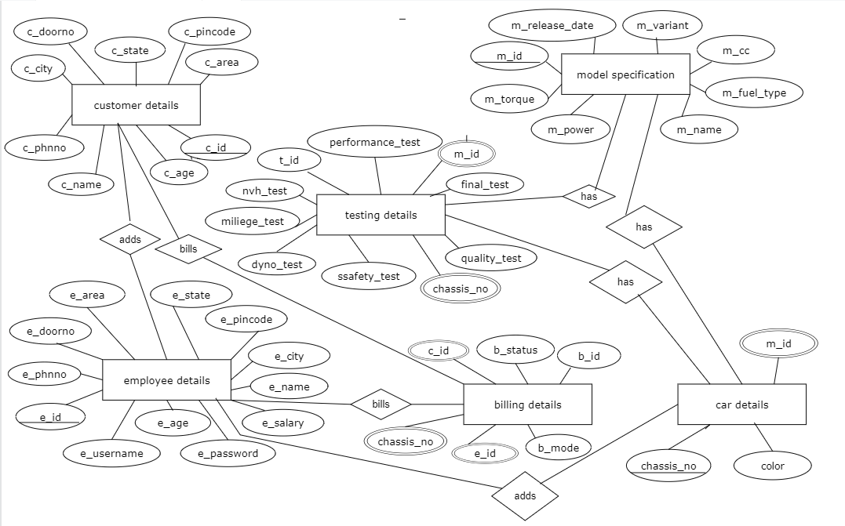

Slide 4
CODE
CREATE TABLE `billing_details` (
`b_id` varchar(10) NOT NULL,
`b_mode` varchar(25) NOT NULL,
`b_status` varchar(4) NOT NULL,
`c_id` varchar(10) NOT NULL,
`e_id` varchar(10) NOT NULL,
`chassis_number` varchar(17) NOT NULL,
PRIMARY KEY (`b_id`),
KEY `bd_fk_1` (`c_id`),
KEY `bd_fk_2` (`e_id`),
KEY `bd_fk_3` (`chassis_number`)
)

Slide 5
CODE
CREATE TABLE `car_details` (
`chassis_number` varchar(17) NOT NULL,
`color` varchar(10) NOT NULL,
`m_id` varchar(10) NOT NULL,
PRIMARY KEY (`chassis_number`),
KEY `cd_fk` (`m_id`)
)

Slide 6
CODE
CREATE TABLE `customer_details` (
`c_id` int(5) NOT NULL AUTO_INCREMENT,
`c_name` varchar(25) DEFAULT NULL,
`c_PhNo` double DEFAULT NULL,
`c_age` int(3) NOT NULL,
`c_pincode` int(6) DEFAULT NULL,
`c_doorNo` varchar(25) DEFAULT NULL,
`c_areaName` varchar(25) DEFAULT NULL,
`c_city` varchar(25) DEFAULT NULL,
`c_state` varchar(25) DEFAULT NULL,
PRIMARY KEY (`c_id`)
)

Slide 7
CODE
CREATE TABLE `employee_details` (
`e_id` varchar(10) NOT NULL,
`e_name` varchar(25) DEFAULT NULL,
`e_PhNo` double NOT NULL,
`e_age` int(3) NOT NULL,
`e_pincode` int(6) DEFAULT NULL,
`e_doorNo` varchar(10) NOT NULL,
`e_areaname` varchar(25) DEFAULT NULL,
`e_city` varchar(25) DEFAULT NULL,
`e_state` varchar(25) DEFAULT NULL,
`e_salary` varchar(10) NOT NULL,
`e_userName` varchar(25) DEFAULT NULL,
`e_password` varchar(25) DEFAULT NULL,
`e_email` varchar(50) DEFAULT NULL,
`e_dept` varchar(25) DEFAULT NULL,
PRIMARY KEY (`e_id`)
)

Slide 8
CODE
CREATE TABLE `model_specifications` (
`m_id` varchar(10) NOT NULL,
`m_name` varchar(25) NOT NULL,
`m_variant` varchar(25) NOT NULL,
`m_fuel_type` varchar(10) NOT NULL,
`m_cc` int(6) NOT NULL,
`m_torque` int(3) NOT NULL,
`m_power` int(3) NOT NULL,
`m_release_date` varchar(8) NOT NULL,
PRIMARY KEY (`m_id`)
)

Slide 9
CODE
CREATE TABLE `testing_details` (
`t_id` varchar(10) NOT NULL,
`performance_test` varchar(4) NOT NULL,
`NVH_test` varchar(4) NOT NULL,
`mileage_test` varchar(4) NOT NULL,
`dyno_test` varchar(4) NOT NULL,
`safety_test` varchar(4) NOT NULL,
`quality_test` varchar(4) NOT NULL,
`final_test` varchar(4) NOT NULL,
`chassis_number` varchar(10) NOT NULL,
KEY `td_fk_2` (`chassis_number`)
)

